Slide 1
Predicting Gas Consumption in Residential Buildings using Machine Learning
Kaiyue Zhang
C21086707
BEng Architectural Engineering
Supervisor: Prof. Monjur Moushed
Date of Presentation: 22/04/2024

Slide 2
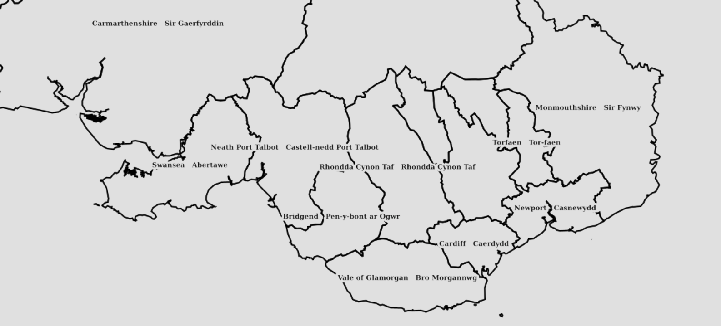



Introduction
Project aims:
Develop a machine learning model which is capable of accurately predicting natural gas consumption in residential buildings. By deeply analysing historical energy consumption data and building characteristics, this model will be a powerful tool for engineers, urban planners and energy companies.
Project details : The Random Forest (RF) algorithm was chosen to build the model and analyse the forecasting data for gas consumption in residential buildings in three major cities in Wales-
Cardiff
Swansea
Newport

Slide 3
Existing research and methods
Orthotropic models (physics-based models) require a large number of inputs but are usually inefficient due to difficult data access and time-consuming processes.
Data-driven models (machine learning-based models) do not require detailed building physics inputs and are trained mainly with data from building management systems and smart meters.
Pham, A.-D. et al. (2020) ‘Predicting energy consumption in multiple buildings using machine learning for improving energy efficiency and Sustainability’, Journal of Cleaner Production, 260, p. 121082. doi:10.1016/j.jclepro.2020.121082.
Notes:
There are 2 main type of methods been using,
Traditionally, physics-based models require a great deal of detailed information, such as the thermal properties of the materials used for walls, roofs and windows, as well as the geometry of the building, the thermal set-up and internal loads generated by occupants, lighting and equipment. These tools, although comprehensive, will often face limitations due to the complexity of the data required and the time-consuming nature of their use, especially when analysing energy on a larger scale, such as an entire city.
On the other hand, data-driven approaches are based on artificial intelligence and the Internet of Things (IoT). These methods use historical data to more effectively understand and predict building energy consumption patterns. Many Machine learning models have shown great potential in predicting future building energy use.

Slide 4
Machine Learning in Building Energy Prediction
Model Performance Evaluation:
Using multiple datasets to improve model generalisation.
Prediction Models: Random Forests (RF), Artificial Neural Networks (ANN), Decision Trees (DT), Adaptive Neuro-Fuzzy Inference Systems (ANFIS), and Support Vector Machines (SVM)
Potential benefits of energy optimisation:
Reduce energy demand and greenhouse gas emissions.
Increased energy security and economic savings.
Fathi, Soheil et al. (2019) ‘Machine learning applications in Urban Building Energy Performance Forecasting: A systematic review’, Renewable and Sustainable Energy Reviews, 133, p. 110287. doi:10.1016/j.rser.2020.110287.
Olu-Ajayi, R. et al. (2021) ‘Building energy consumption prediction for residential buildings using Deep Learning and other machine learning techniques’, Journal of Building Engineering, 45, p. 103406. doi:10.1016/j.jobe.2021.103406.
Notes:
Various studies have proposed machine learning-based prediction models to predict future building energy use.
For example, the main machine learning models applied to building energy prediction include (RF), (ANN), (DT), (ANFIS) and (SVM)
Efficient use of energy reduces energy demand, thereby increasing monetary savings, reducing greenhouse gas emissions, and increasing energy security.

Slide 5
Random Forest Models in Energy Consumption Forecasting
RF model advantages:
Powerful machine learning technique, especially suitable for regression problems.
Excellent performance in predicting hourly energy consumption in educational buildings.
Performance Comparison:
Compared to regression tree and support vector regression (SVR) models:
14-25% improvement in prediction accuracy (regression tree)
5-5.5% improvement in prediction accuracy (SVR)
Wang, Z. et al. (2018) ‘Random Forest based hourly building energy prediction’, Energy and Buildings, 171, pp. 11–25. doi:10.1016/j.enbuild.2018.04.008.
Notes:
In the field of machine learning, Random Forest (RF) algorithms are powerful and efficient tools for dealing with complex and high-dimensional data from various industries. During reasch, RF accelerates the training process through an ensemble approach that integrates multiple decision trees to produce the output. This approach not only ensures stability, but also improves the accuracy of predictions.
Comparative results showed that the RF model improved the prediction accuracy by 14-25% and 5-5.5% compared to the regression tree and SVR models.

Slide 6
Achievements
Step 1: Data Collection
Collected data from official sources, including energy performance certificates (EPC) and weather-related data.
Step 2: Data Cleaning
Manually reviewed the EPC data to identify and remove unnecessary information.
Step 3: Data Selection for Model Training
Determined the relevant data to use as features for model training, with energy consumption set as the target variable.
Step 4: Cross-Validation
Conducted cross-validation on the dataset to identify the optimal hyperparameters.
Step 5: Model Training and Evaluation
Trained the Random Forest model using the selected optimal parameters and evaluated the model using metrics such as MSE (Mean Squared Error) and R² (R-squared).

Slide 7
Has the work proceeded according to the project aims?
The project has generally progressed towards the intended aims, using cross-validation to determine appropriate hyperparameters and focusing on optimizing model accuracy within computational constraints. However, the best hyperparameters were sometimes not utilized due to excessive computation times, which limited the ability to achieve results promptly.
Early in the project, the small size of the dataset and insufficient utilization of data features led to significant deviations in results, which necessitated reevaluation and adjustments in the approach.
In order to address the initial frustrations and improve the model's robustness and accuracy, the dataset was expanded to incorporate a larger volume of data and a wider range of data features. This change provides a more complete analysis and reduces the prediction errors previously encountered.

Slide 8
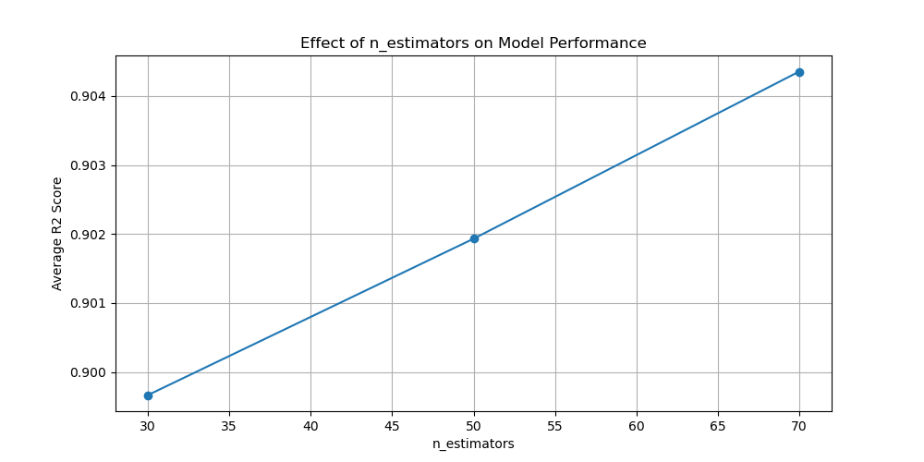
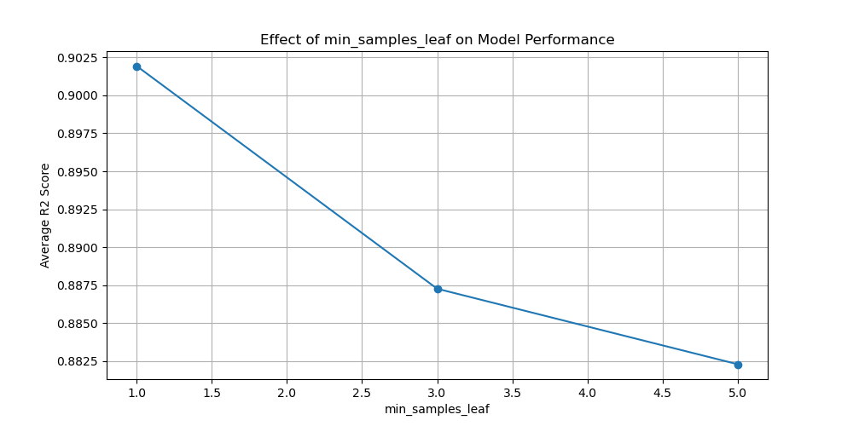
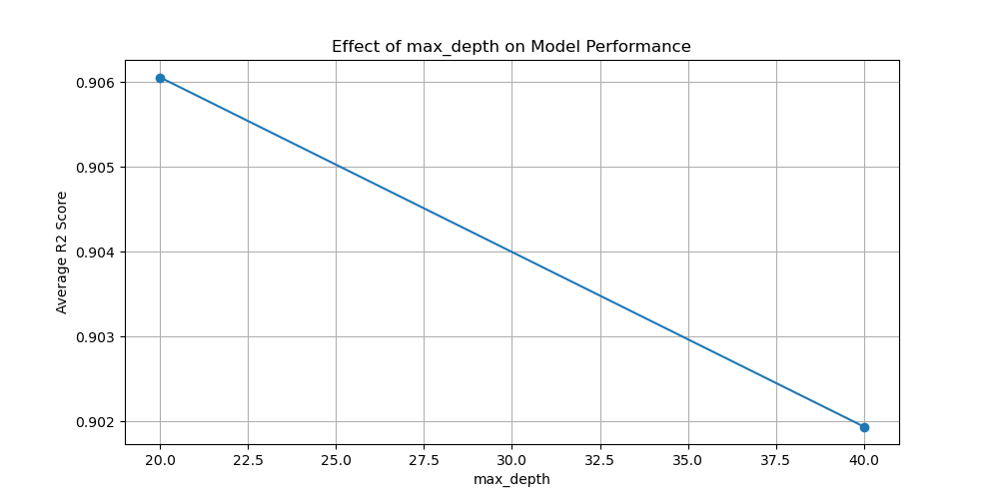
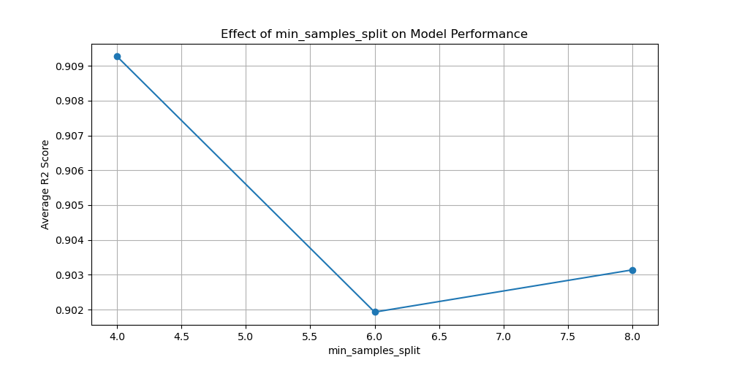
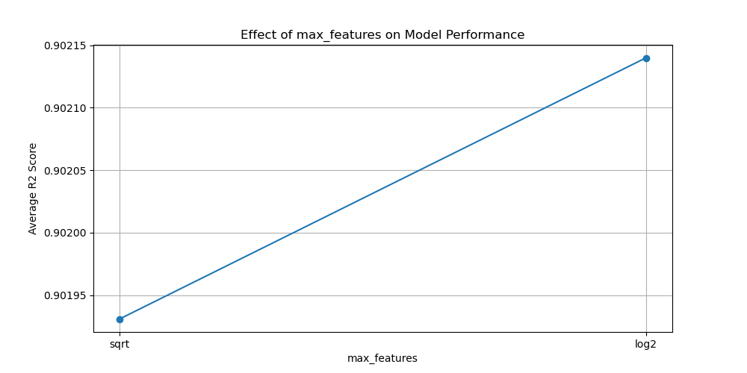
Data
Data
n_estimators= 50, min_samples_split= 6, min_samples_leaf=1, max_features='sqrt', max_depth= None
Cardiff Best Cross-validation Score: 0.9687433067444013
Swansea Best Cross-validation Score: 0.9130872061542757
Newport Best Cross-validation Score: 0.9019310223563243

Slide 9
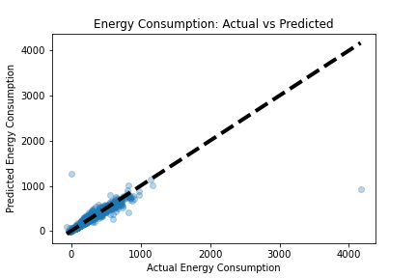
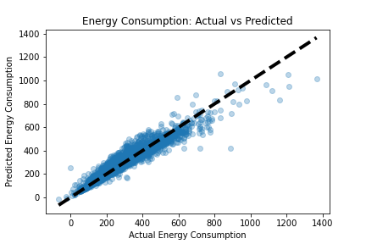
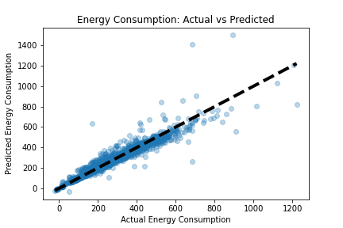
Predictions
Cardiff
R2 Score: 0.9376619183097451
Mean Squared Error: 574.7910615596347
Swansea
R2 Score: 0.9653970417418436
Mean Squared Error: 386.923444088019
Newport
R2 Score: 0.9648205329602142
Mean Squared Error: 345.77621175269303
Cardiff
Swansea
Newport

Slide 10
Conclusion
Major Achievements
Processing data
Efficient collection and cleansing of key datasets to ensure a solid foundation for model development.
Data analysis techniques
Applied manual selection procedures to identify relevant features from EPC data to optimise data for more effective modelling.
Optimising model parameters
Identify optimal hyper-parameters through cross-validation to improve the accuracy and performance of the model in predicting energy consumption.
Effective model training
Training the model using the Random Forest algorithm and the best available hyper-parameters achieved satisfactory metrics (MSE and R²), proving the reliability and accuracy of the model predictions.

Slide 11
Conclusion
Major problems encountered and future solution strategies
Computational limitations
Some of the optimal parameters were not utilised due to the high volume of computation.
Initial Data Limitations
Small initial dataset and insufficient usage of available features led to significant inaccuracies in predictions.
Utilisation of results in future work
Model improvements and extensions Improved modelling techniques and parameter optimisation processes can be used to extend models to accommodate larger and more complex datasets.
The integration of the developed models with real-time data systems or IoT devices can lead to the development of dynamic energy management systems that automatically predict and adjust energy consumption patterns to optimise energy use.

Slide 12
Q&A Sessions
Thank you!

